Slide 1
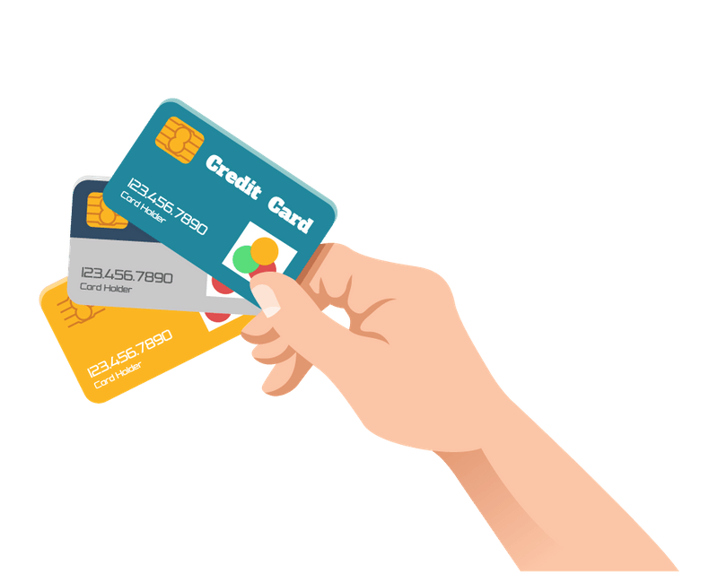
Credit Card Fraud Detection
Presented by:
K Guruprasad
Mithun Kumar

Slide 2

INTRODUCTION
Credit card fraud is rising due to online shopping and digital payments.
There is a critical need for robust fraud detection mechanisms.
This project aims to develop a systematic approach to detect fraud.
Analysis of past transaction data is central to the project.
Data analysis techniques will be used to classify transactions.
The analysis supports immediate fraud detection.
Continuous learning enhances the overall performance of detection systems.

Slide 3

ABOUT DATASET
The dataset is sourced from Kaggle, includes transactions by European cardholders from Sept 2013.
It consists only of numerical input variables resulting from PCA transformation.
Original features and detailed background information are not available due to confidentiality.
Features V1 to V28 are principal components derived from PCA.
The 'Time' feature represents seconds elapsed since the first transaction.
The 'Amount' feature indicates the transaction amount and supports cost-sensitive learning.
The 'Class' feature is the response variable, where 1 indicates fraud and 0 indicates legitimate transactions.

Slide 4

OBJECTIVES
To explore and understand the features of the credit card fraud dataset.
To perform data pre-processing, including handling missing values and outliers.
To identify significant features influencing credit card fraud through statistical analysis.
To build predictive models that accurately classify transactions as fraudulent or legitimate.
To visualize results and present actionable insights to improve fraud detection mechanisms.

Slide 5
METHODOLOGY
Data Collection: The dataset will be sourced from Kaggle, ensuring it is well-documented and reliable.
Exploratory Data Analysis (EDA): Handle missing data using imputation techniques, Summarize the dataset using descriptive statistics and Create visualizations (e.g., histograms, box plots, correlation heatmaps) to understand feature distributions and interactions.
Modelling: Split the dataset into training and testing subsets. Train various models (e.g., Logistic Regression, Decision Trees, Random Forest, etc.) and assess their performance using metrics such as accuracy, precision, recall, and F1-score. Optimize hyperparameters to enhance model performance.
Evaluation and Interpretation: Compare model performances and select the best-performing model. Interpret results to comprehend the impact of different features on fraud detection.
Visualization: Generate visual representations of findings to support conclusions.
Reporting: Compile analysis, results, and insights into a detailed report.

Slide 6
TOOLS AND TECHNOLOGIES
Programming Language: Python
Libraries: Pandas, NumPy, Matplotlib, Seaborn, Scikit-learn
IDE: Jupyter Notebook or any Python-compatible IDE
Data Source: Kaggle dataset (Credit Card Fraud Detection Dataset)

Slide 7
EXPLORATORY DATA ANALYSIS (EDA)
Importing Libraries: Import essential libraries for data manipulation and visualization.
Loading Dataset: Load the dataset containing anonymized features and transaction classes.
Basic Exploration: Use head(), tail(), shape, and info() to explore dataset structure and summary.
Checking Missing Values: Identify potential missing data issues with isnull().sum().
Descriptive Statistics: Obtain statistics like mean and quartiles with describe().
Identifying Duplicates: Check for duplicate transactions using duplicated().any().
Analyzing Class Distribution: Assess class balance with groupby('Class').mean().

Slide 8
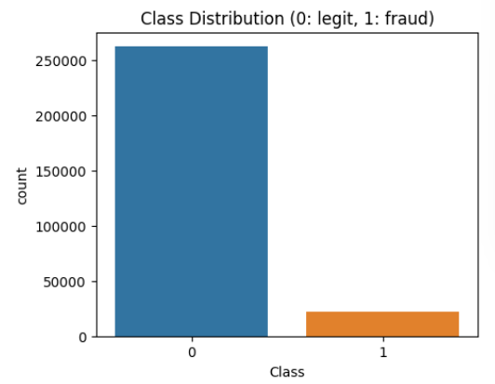
DATA VISUALIZATION
Count Plot: A count plot visualizes the frequency of categories, making it easy to compare group sizes and identify imbalances in data, such as legitimate versus fraudulent transactions.

Slide 9
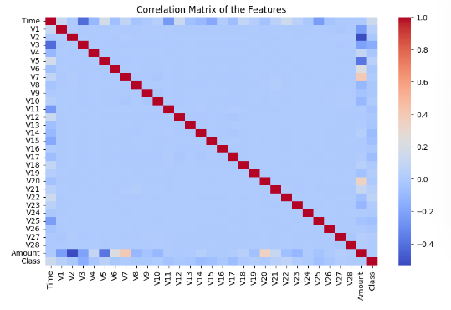
DATA VISUALIZATION
Correlation Matrix: Correlations can provide insights into which features are related to each other and to the target variable (Class). We can focus on the features that are strongly correlated with fraud..

Slide 10
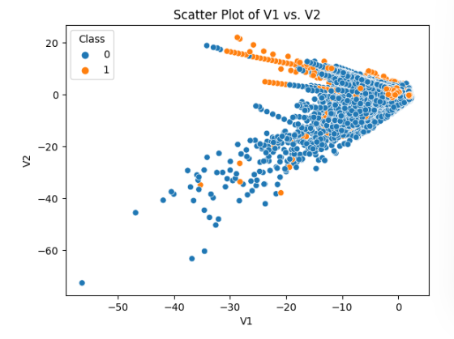
DATA VISUALIZATION
Scatter Plot: A scatter plot is created to visualize the relationship between the features in the dataset, with points colored based on their respective classes.

Slide 11
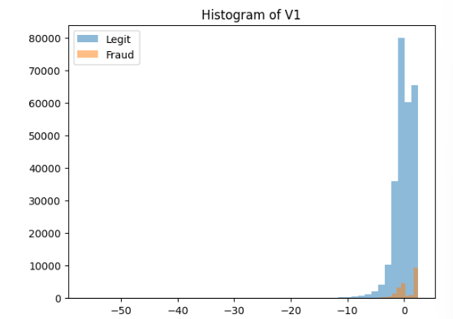
DATA VISUALIZATION
Histogram: A histogram is generated to compare the distribution of the feature for two categories: Legit and Fraud, facilitating a visual comparison of their distributions.

Slide 12
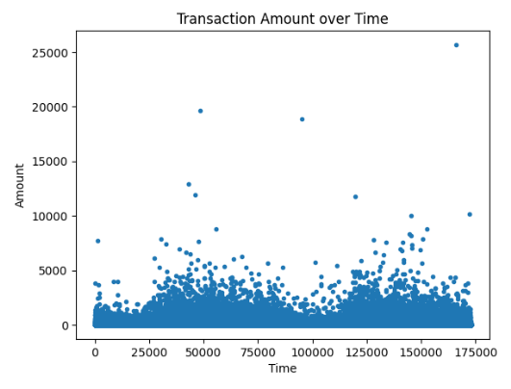
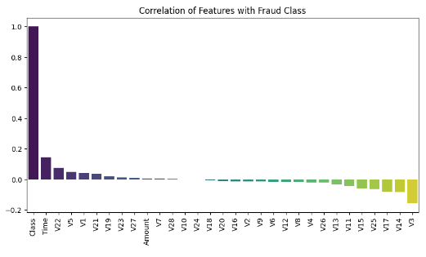
DATA VISUALIZATION
Plot of Transaction amount over Time
Correlations with the target variable (Class)

Slide 13
MODELLING
Importing necessary Libraries
Train Test Split
Model Training
Model Prediction
Logistic Regression Model Evaluation
Support Vector Machine (SVM) Model Evaluation
Random Forest Model Evaluation
XGBoost Evaluation
Model Evaluation Metrics
Confusion Matrices

Slide 14
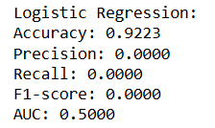
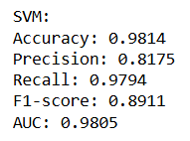
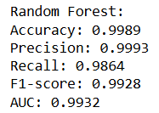
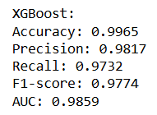
EVALUATING MODEL PERFORMANCE

Slide 15
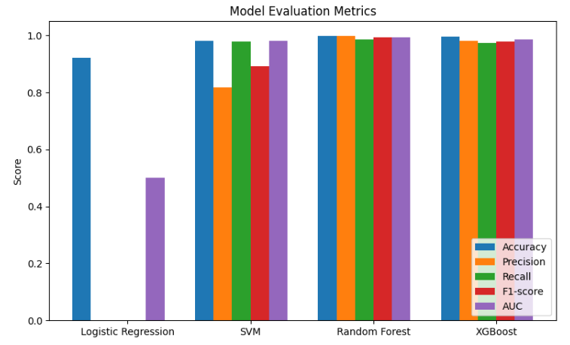
VISUALIZING THE METRICES

Slide 16
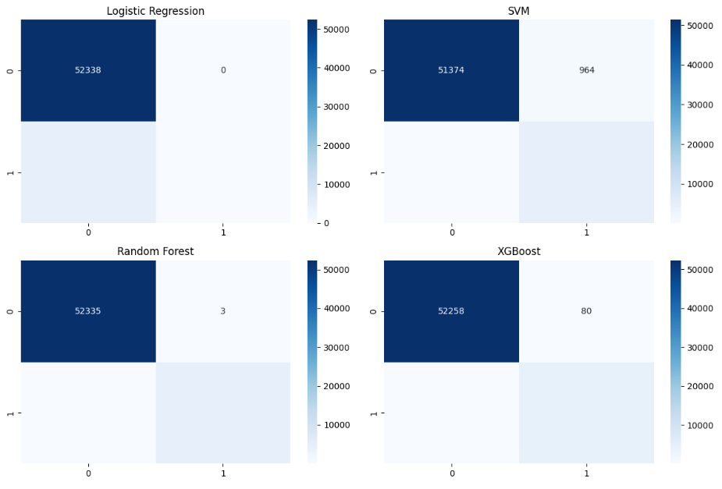
CONFUSION MATRICES

Slide 17

CONCLUSION
This project aims to enhance the understanding of credit card fraud detection by applying data analysis techniques. The insights gained from this analysis will provide valuable information to financial institutions, aiding in the development of more effective fraud prevention strategies, ultimately leading to increased customer trust and safety in digital transactions.

Slide 18


